Slide 1



a00s3e3 - DONE
F= -1.77969
F = -1.77893
F= -1.77588, unstable

Slide 2










a00s5e3 - DONE
F = -2.986
F = -2.98574
F = -2.98733
F = -2.98580
F = -2.98637
F = -2.98644

Slide 3


a00s7e3 - DONE
F = -4.20090
F = -4.20224
Terran tried stripe (15.2, 20.2) & (12.2, 20.2). Unstable

Slide 4

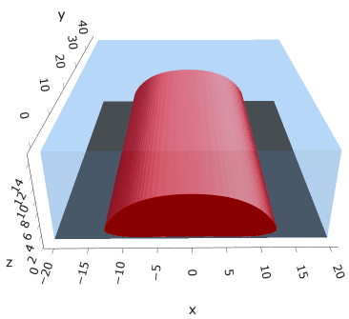

a05s3e3
F = -1.77283
F = -1.77213
F = -1.77005

Slide 5


a05s5e3
F = -2.97422
F = -2.97365

Slide 6
a05s7e3
str
hol
hom

Slide 7
a05s010
str
hol
hom

Slide 8



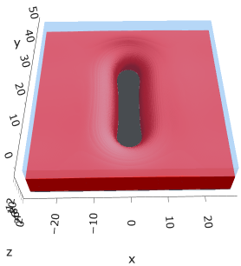

a10s5e3 - DONE
F = -2.93788
F = -2.93873
F = -2.93788

Slide 9

a20s5e3
F = -2.82020

Slide 10
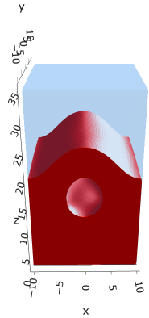
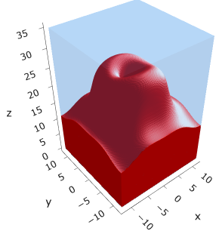
a20s015
F = -8.43694
F = -8.43183

Slide 11

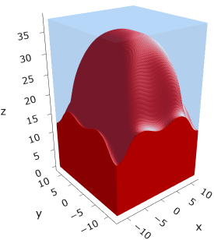
a20s022
F = -12.3420

Slide 12
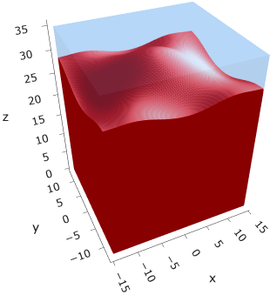
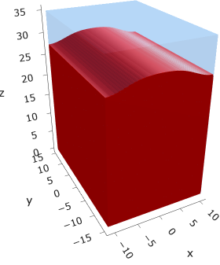

a20s025
F = -14.0024
F = -14.0028
F = -13.9755

Slide 13
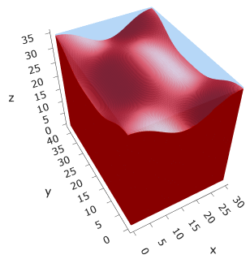



a20s027
F = -15.1046
F = -15.1047
F = -15.0898
F = -15.1050
Note: 2C isomin = 0.50

Slide 14
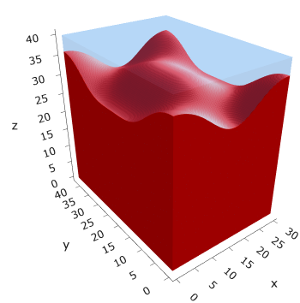
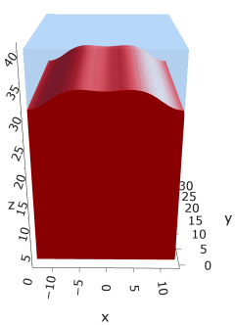

a25s027
F = -14.6053
F = -14.6017
F = -14.6015
Mul seems unstable (separation between layers low)

Slide 15
a25s030
Mul
hom

Slide 16
a30s020
str
mul
Hom seems unstable for (0.4, 0.4)

Slide 17
a30s025
str
mul
hom

Slide 18





a35
s10
s12
s15
s18

Slide 19



Parallelization
$$α=0, χ=1.25, N=50, σ=0.02$$
$$α=0, χ=1.25, N=200, σ=0.005$$
$$L_{x}=L_{y}=23, { L}_{z}=15$$
Nth = 12: 500 it, 4.3 hrs
Nth = 8 : 500 it, 6.9 hrs
Nth = 6 : 415 it, 20 hrs (poss. mem bottleneck)

Slide 20







Exercise: Micelle / Stripe
s = 5e-03, N = 50, a = 0.0, x = 1.0
s = 5e-03, N = 75, a = 0.0, x = 1.0
Isosurface at pha = 0.1

Slide 21






a040x170s020

Slide 22






a040x170s010

Slide 23

a040x170s025

Slide 24














a040x170s022

Slide 25










a040x170 seed
See if becomes hex
cyl4-975
cyl4-12
cyl16-975
cyl16-1025
cyl1

Slide 26






a040x170s017

Slide 27












































a040x170s015 seed
Almost done
Almost done

Slide 28

















a040x170s013

Slide 29
















a040x170s010 seed

Slide 30














X200 x170 x130 x120 x100
F = −10.24458
F = − 9.14301
F = −11.0057
F = −10.2429
F = −11.0015
F = −9.63949
F = −10.2461
F = −10.9948
F = − 9.63030
F = −10.2431
F = −10.9953

Slide 31





a040x100 relaxation

Slide 32








































a040x100 seed
old
old

Slide 33


a040x120 relaxation
F = −10.24458

Slide 34





































a040x120 seed
cyl16-850
cyl16-825

Slide 35






a040x130 relaxation

Slide 36




a040x170 relaxation
F = −9.10347
1 neck

Slide 37







a040x200 relaxation

Slide 38










a040x200 seed
Note: not completely converged but stopped for resources

Slide 40


a0.40 x1.70

Slide 41





Zhulina JCP 1998
a = 0.01
0.1 mM
1 mM
May need to init using sine
10 mM
25 mM
Zhulina NVT; current GCE runs at Lz = 20

Slide 42

Carrillo Langmuir 2009

Slide 43

Parallelization

Slide 44
Equations
Quenched average, np, A --> \inf ; np/A → \sigma
Discrete Gaussian chain

Slide 45




Scaling (Alexander—de Gennes brush)
V = 4.2; H = 27.5 – 30.5
V = 2; H = 39 – 45.5

Slide 46






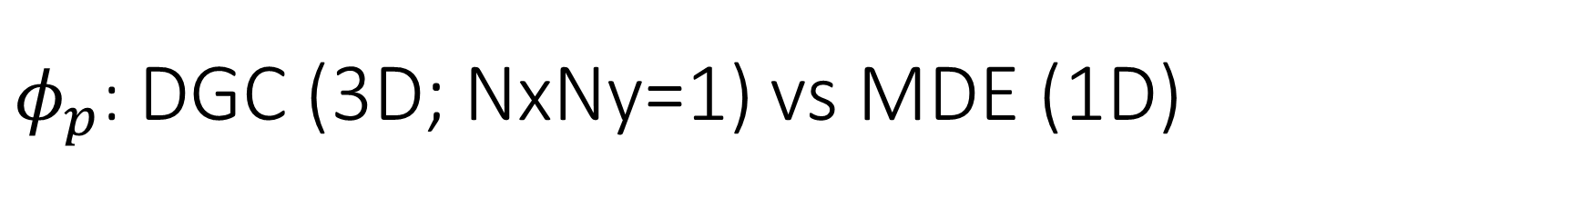
$φ_{p}$: DGC (3D; NxNy=1) vs MDE (1D)
Ns/sigs: dz = 0.10, Ngz_2 = 4$σ$; Chis/bs: dz = 0.25, Ngz_2 = 3.5$σ$

Slide 47


Numericals
Ys
Possibly do Ngz for multiple dzs

Slide 48








3D
Lxy = 1
Lxy = 10
Lxy = 5
Lxy = 15
y-z heatmaps for $φ_{p}$ at constant x

Slide 49





z-FFT vs z-FD (MDE) – REDFT01 xy(z)
Lx = 5, Ly = 5, Lz = 50. s = 0.02. x = 0.75. a = 0.00, N = 50
3D vs 1D (dashed): dz = 0.5, ds = 0.20; dz_1D = 0.113, ds_1D = 0.083
FFT (xyz)
FFT (yz vs pha)
FD (xyz)
FD (yz vs pha)
Diff btw 1D/3D should just be dz, ds, etc.

Slide 50
Specifying Grafted Points

Slide 51
Strategy
2D binary array for surface sites of homogeneously grafted polymer given grafting density, simulation box size, and discretization (and assuming dx = dy)
Fullspace must be periodic on x0 = xL, y0 = yL
Halfspace must be even on xL/2 and yL/2 (overlap of boundary following REDFT00) and periodic on x0 = xL, y0 = yL.
Homogeneous spacing as determined by regular hexagon, where grafting point at centroid of hexagon
In case there are edge effects, try shifting the centroids away from the boundaries of the xy-plane (only did for fullspace)
Make sure no edge effects by comparing results of full FFT with cos FFT

Slide 52
Test conditions
Sigma = 0.05 c/nm2
Lx = 15 nm
Ly = 15 nm
dx = 0.4 nm
Cast in terms of dx (for rounding and PBC for grafting points):
Sigma = 0.0668 c/nm2
Lx = 14.80 nm
Ly = 11.20 nm
(Sigma error decrease with dx)

Slide 53

Padded PBC (Full FFT)
Hexagons drawn for illustration of hexagon approach

Slide 54

Unpadded PBC (Full/Cos FFT)

Slide 55






Other conditions (full and half results overlapped to show match)
s = 0.0241 (20.28%; dx=0.4), Lx, Ly = 12.40, 20.80
s = 0.0208 (4.08%; dx=0.1), Lx, Ly = 12.90, 22.30
s = 0.1332 (11%; dx=0.1), Lx, Ly = 20.50, 20.40

Slide 56


